Slide 1

CROP RECOMMENDATION SYSTEM
Submitted By: Akanksha Sharma
Roll no: 22BCON1108
Section: K

Slide 2
INTRODUCTION
Agriculture plays an important role in the Indian economy. Selecting the correct crop for cultivation is a challenge for farmers because the decision depends on several environmental and soil-related factors. Traditional methods rely on intuition and past experience, which may not always lead to optimal crop selection. Machine learning provides an efficient and scientific way to analyze soil nutrients and climatic parameters to recommend the most suitable crop. This project introduces a Crop Recommendation System that uses Nitrogen, Phosphorus, Potassium, temperature, humidity, pH, and rainfall as inputs to predict the best crop for cultivation. The system uses an XGBoost Classifier inside a preprocessing pipeline and is deployed through a Gradio interface to allow users to interactively get predictions. This improves decision-making and supports sustainable agriculture

Slide 3
OBJECTIVES
1. To develop an intelligent system that recommends the most suitable crop based on soil nutrients and environmental conditions.
2. To apply Machine Learning techniques—specifically XGBoost Classifier—to improve the accuracy of crop prediction.
3. To preprocess and analyze agricultural data for identifying important patterns and correlations.
4. To build a scalable ML pipeline that automates encoding, scaling, and prediction.
5. To create a user-friendly interface using Gradio that allows real-time crop recommendations.
6. To support farmers in decision-making by providing data-driven crop suggestions.
7. To reduce crop failure by recommending crops that match soil fertility and climate.

Slide 4
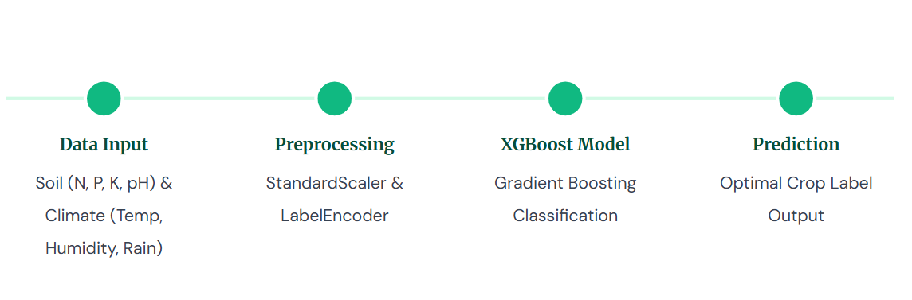
SYSTEM ARCHITECTURE

Slide 5
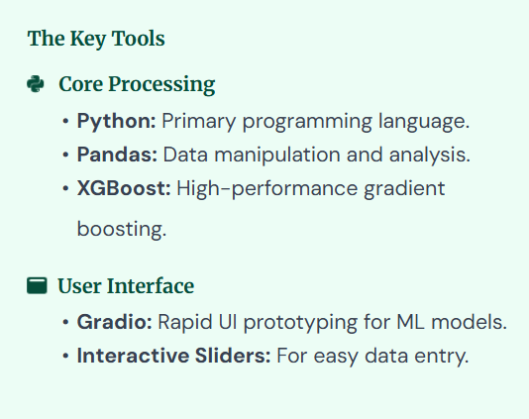
TECHNOLOGY STACK

Slide 6
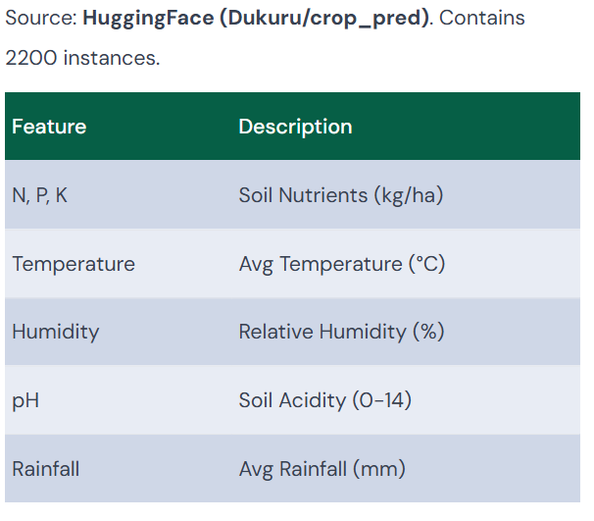
Dataset & Features

Slide 7

Extreme Gradient Boosting (XG Boost) is chosen for its superior speed and performance on structured data.
Why XG Boost?
High Accuracy: Uses ensemble learning to correct errors of previous trees.
Regularization: Prevents overfitting, ensuring the model generalizes well to new data.
Efficiency: Optimized for speed, making it suitable for real-time recommendations.

Slide 8
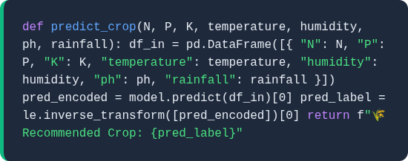
PREDICTION FUNCION
The core logic takes user inputs, structures them into a Data Frame matching the training schema, passes them through the pipeline, and decodes the result back to a readable string.

Slide 9

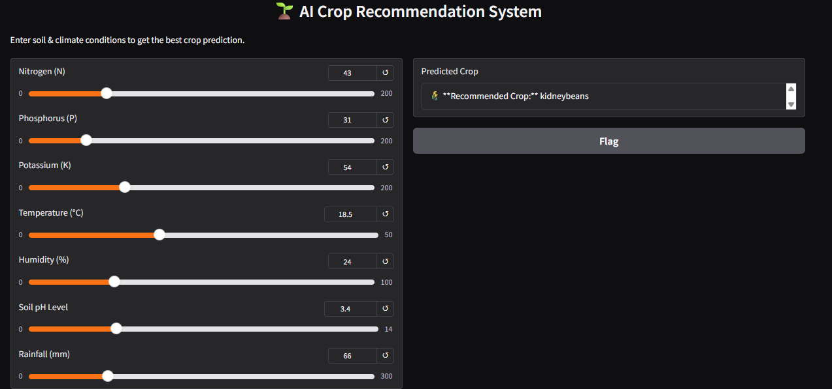
CODE IMPLEMENTATION &UI

Slide 10
CONCLUSION & IMPACT
Empowering Agriculture
This system bridges the gap between advanced data science and traditional farming.
99% Accuracy: Reliable predictions based on historical data.
Sustainability: Prevents soil depletion by suggesting appropriate rotation.
Future Scope: Can be integrated with IoT sensors for real-time automated analysis.

Slide 11


